Slide 1
Alamo Area Metropolitan Planning Organization
June 2018

Slide 2
What is an MPO?
A regional, multi-modal transportation planning agency created by federal law to:
provide a forum for project selection by local officials
set policy and guide the transportation planning process
develop a multi-modal, 25-year Metropolitan Transportation Plan (MTP)
develop a multi-modal, four year Transportation Improvement Program (TIP)

Slide 3
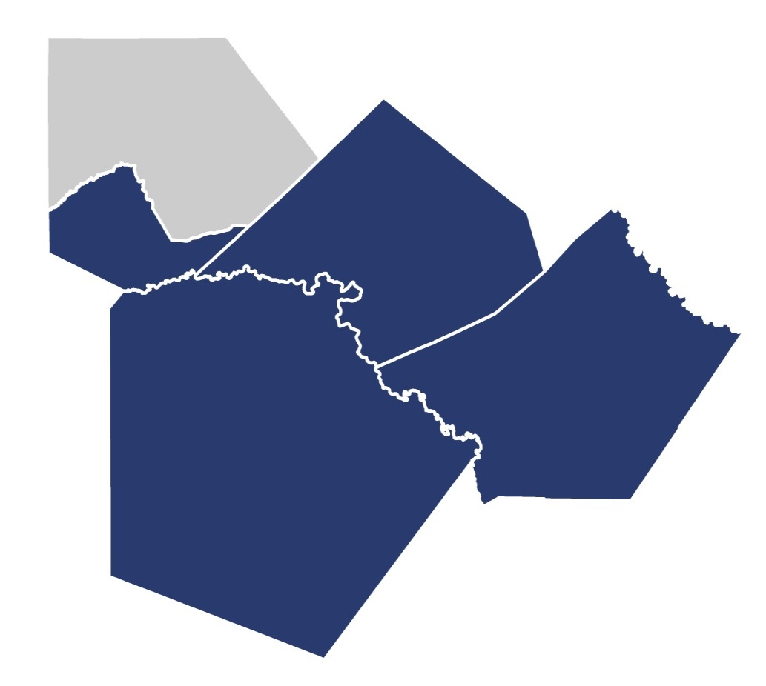
AAMPO Study Area
2 million
Kendall
residents
Comal
10,000
Guadalupe
lane miles
Bexar
50 million
miles traveled daily

Slide 4
We plan to keep you moving
Cooperative
No single agency has responsibility for the entire transportation system
Comprehensive
Encompassing all transportation modes, as well as local land use and economic development plans
Continuous
Ongoing planning should take place to address both short and long term transportation vision and needs

Slide 5
AAMPO Transportation Policy Board
Transportation Policy Board Member | Representing
Commissioner Kevin Wolff, MPO Chair | Bexar County
Councilman Rey Saldaña, MPO Vice-Chair | City of San Antonio
Ms. Jordana Matthews | Advanced Transportation District
Mr. Michael J. Lynd, Jr. | Alamo Regional Mobility Authority
Commissioner Tommy Calvert, Jr. | Bexar County
Commissioner Sergio Rodriguez | Bexar County
Ms. Renee Green, P.E., County Engineer | Bexar County
Commissioner Kevin Webb | Comal County
Councilman Ron Cisneros | Kendall County Geographic Area
Mayor Pro Tem Wayne Peters | City of New Braunfels
Councilwoman Shirley Gonzales | City of San Antonio
Councilman Greg Brockhouse | City of San Antonio
Councilwoman Ana E. Sandoval | City of San Antonio
Ms. Bridgett White, Planning Director | City of San Antonio
Mr. Mike Frisbie, P.E. TCI Director | City of San Antonio
Mayor Don Keil | City of Seguin
Mayor Chris Riley, Leon Valley | Greater Bexar County Council of Cities
Judge Kyle Kutscher | Guadalupe County
Councilman Kevin Hadas, Selma | Northeast Partnership
Mr. Mario Jorge, P.E., District Engineer | TxDOT San Antonio
Ms. Patricia Rodriguez | VIA Metropolitan Transit

Slide 6
Unified Planning Work Program (UPWP): MPO Staff Budget and Planning Studies over a two year timeframe (adopted June 2017)
Metropolitan Transportation Plan (MTP): Future goals, strategies and transportation projects for 25 years (adopted December 2014); new Plan horizon year is 2045 and scheduled for adoption in December 2019
Transportation Improvement Program (TIP): Funded transportation projects within 4 years (adopted in April 2018)
Notes:
The MPO is responsible for developing three planning documents for the region.
The Unified Planning Work Program covers a two year timeframe and includes MPO operations, and planning studies.
The Transportation Improvement Program, covers a four year timeframe, is financially constrained, and is currently being updated with a new TIP expected to be adopted in April 2018.
And finally, the Metropolitan Transportation Plan covers a period of 25 years, is financially constrained, and if we are designated non-attainment for ozone in October 2017, as expected, it will need to be developed by May 2018.
The MPO may also soon be responsible for a fourth document.

Slide 7
Metropolitan Transportation Plan: Mobility 2040

Slide 8
Metropolitan Transportation Plan
Required to be updated every five years
Region’s transportation system investment priorities
25 year planning horizon
Focused on systems level & multimodal in nature
Financially constrained

Slide 9
2045 Population Forecasts
 | Population Forecast |  |  |  | Employment Forecast
 | 2015 | 2045 | Growth | % | 2015 | 2045 | Growth | %
Bexar | 1,898,173 | 3,004,011 | 1,105,838 | 58% | 893,782 | 1,571,410 | 677,628 | 76%
Comal | 134,019 | 287,655 | 153,636 | 115% | 52,683 | 119,352 | 66,669 | 127%
Guadalupe | 165,183 | 365,048 | 199,865 | 121% | 41,862 | 102,824 | 60,962 | 146%
Kendall | 38,314 | 67,539 | 29,225 | 76% | 13,707 | 24,728 | 11,021 | 80%
Total | 2,235,689 | 3,724,253 | 1,488,564 | 67% | 1,002,034 | 1,764,314 | 762,280 | 76%

Slide 10
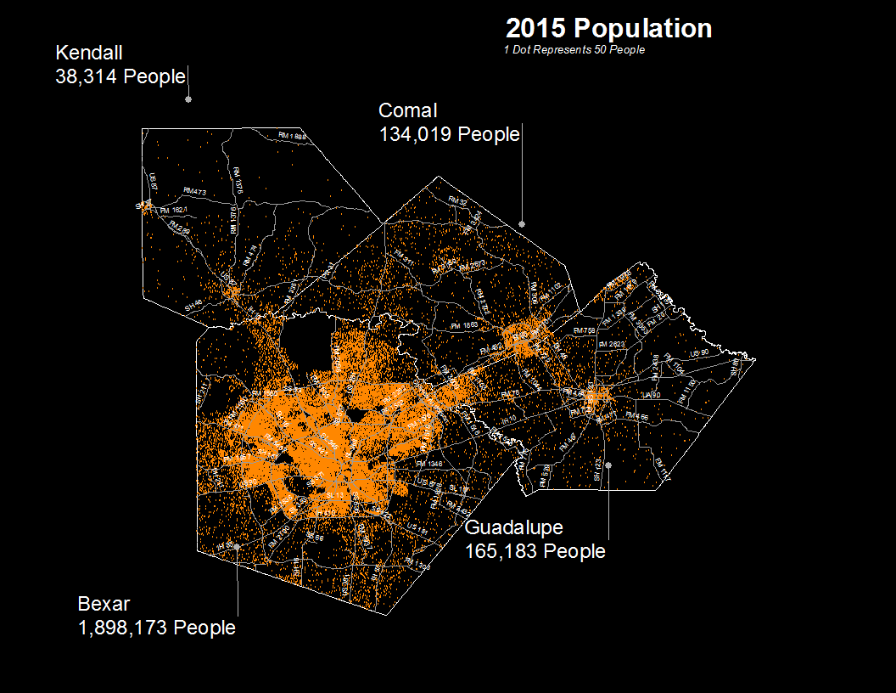
Notes:
This is what our population looked like in 2015. Each dot represents 50 people and in areas that are denser, you might be looking at several dots on top of each other.

Slide 11
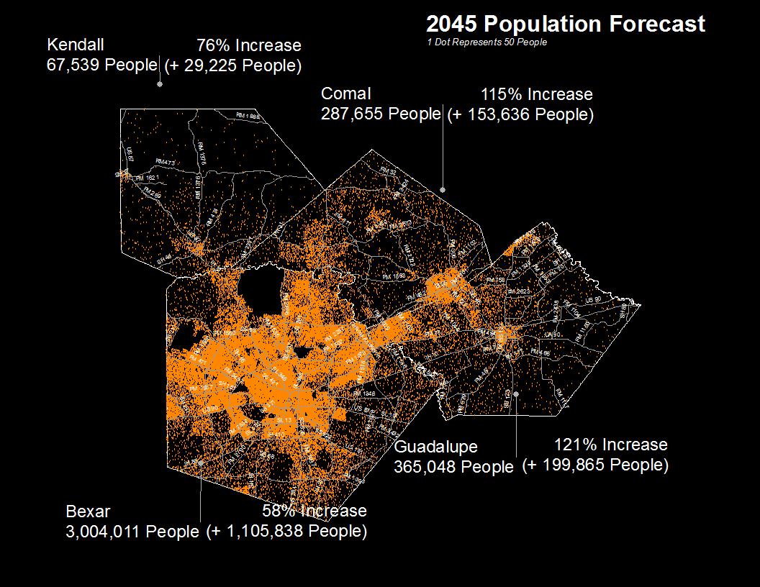
Notes:
Flash forward to 2045 and our population grows significantly.
I’ll toggle back and forth so that you can fully get a sense of the growth.

Slide 12
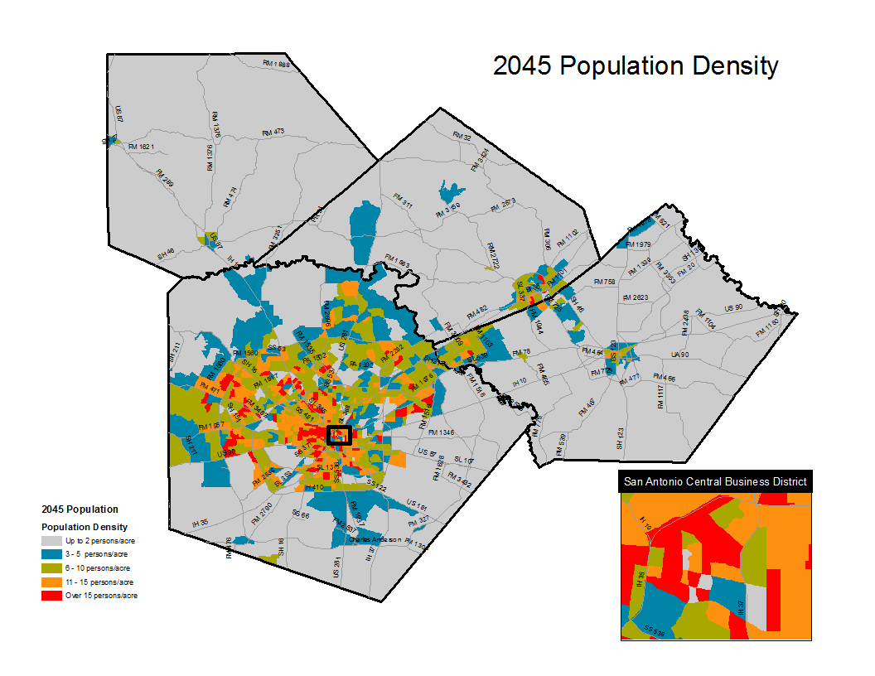
Notes:
This is a density map. Any of the areas in red show spots with over 15 people/acre.

Slide 13
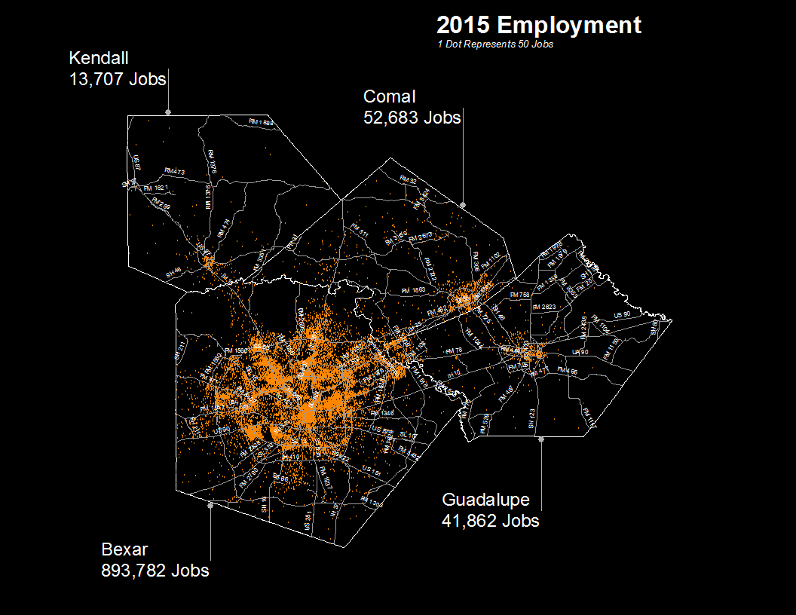
Notes:
Now let’s take a look at employment. Here it is in 2015.

Slide 14
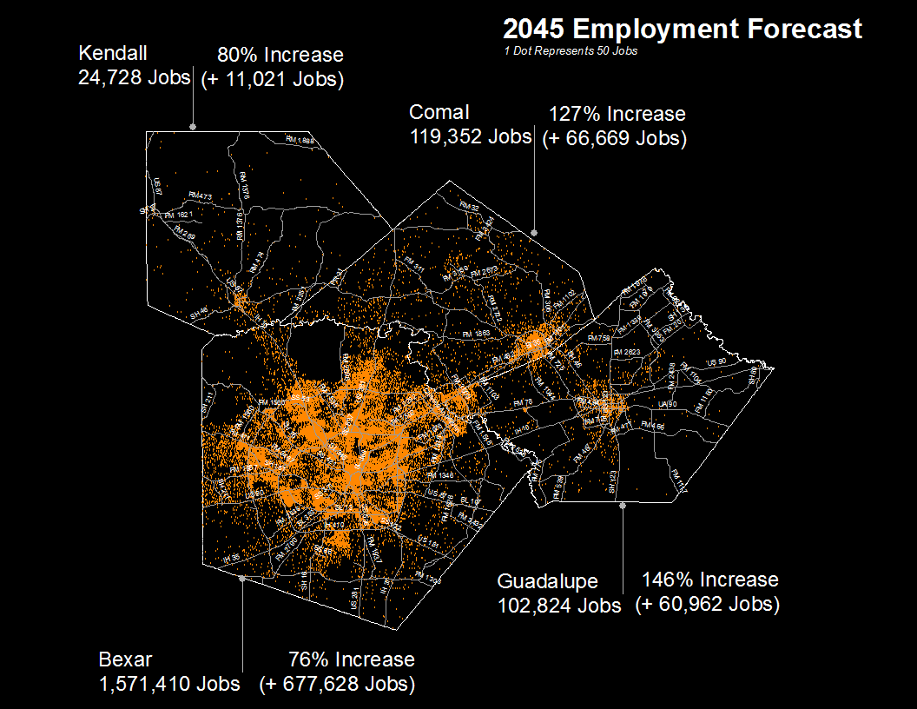
Notes:
And here it is in 2045. Employment growth is showing up more to the north central.
Again, I’ll toggle back and forth so you can get a better sense of the growth.

Slide 15
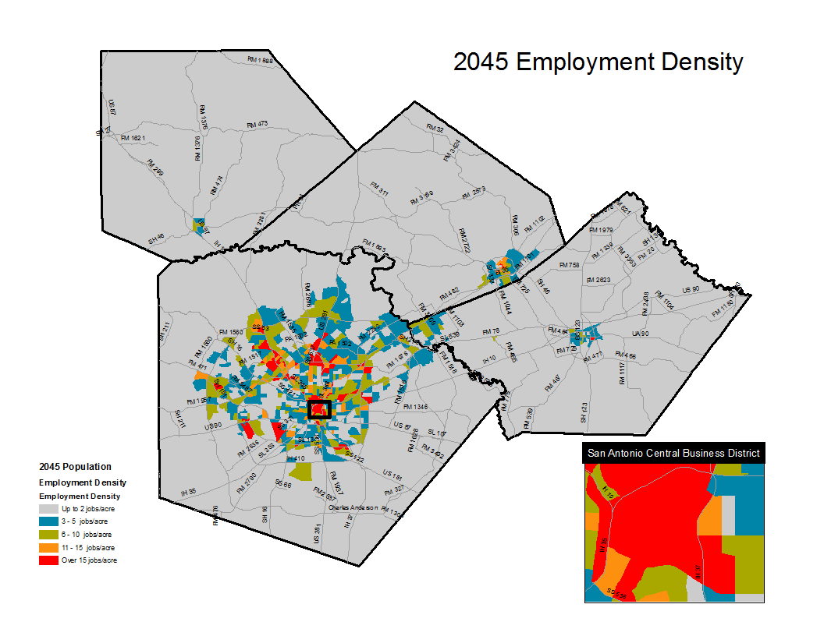
Notes:
And again, here is an employment density map with red showing areas with over 15 jobs/acre.

Slide 16
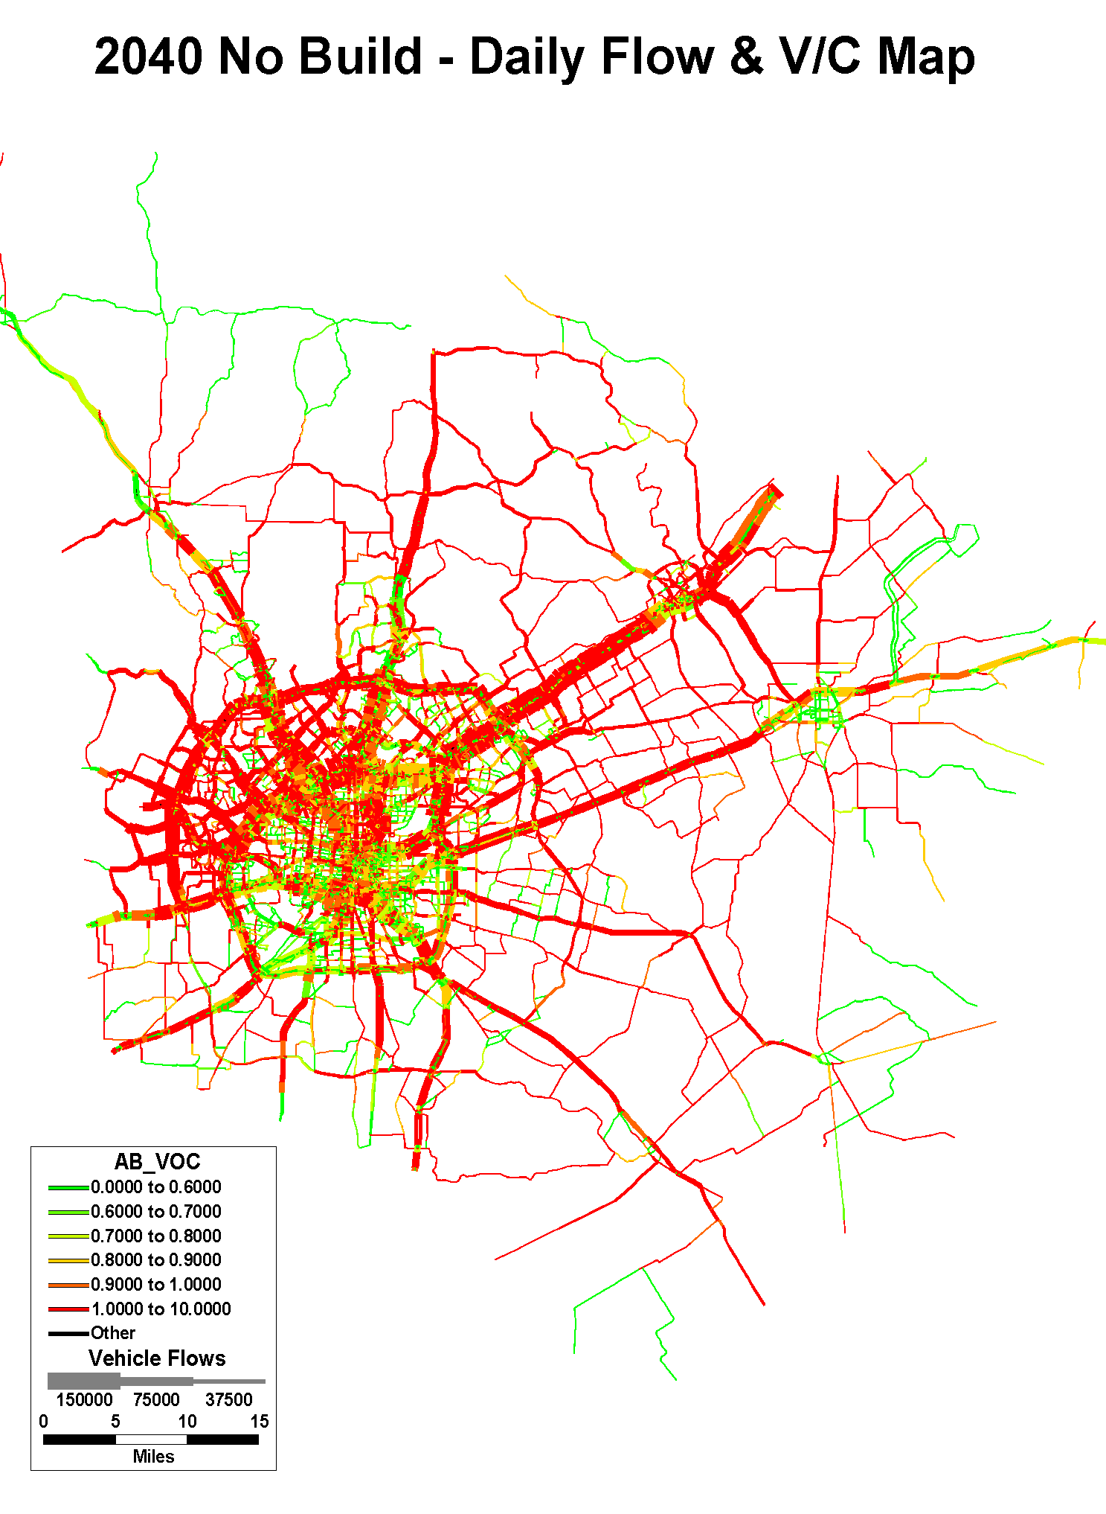
Notes:
We first had to study the impact that population and employment projections would have on our transportation system.
This map illustrates congestion for 2010. It is based on the population and employment in 2010 with the transportation system available in that year.
Generally, green is good and means the roadway is operating well and red means the roadway is operating over capacity and is most likely congested during peak periods.

Slide 17
Mobility 2040: Funding Breakdown
Transit costs include:
purchasing buses, vans and support vehicles
constructing passenger facilities
bus and van on-street operations
maintenance of the system
Transit
Total funding is $17.62 Billion

Slide 18
Mobility 2040: Roadway Funding

Slide 19
Mobility 2040: Unfunded Needs through

Slide 20
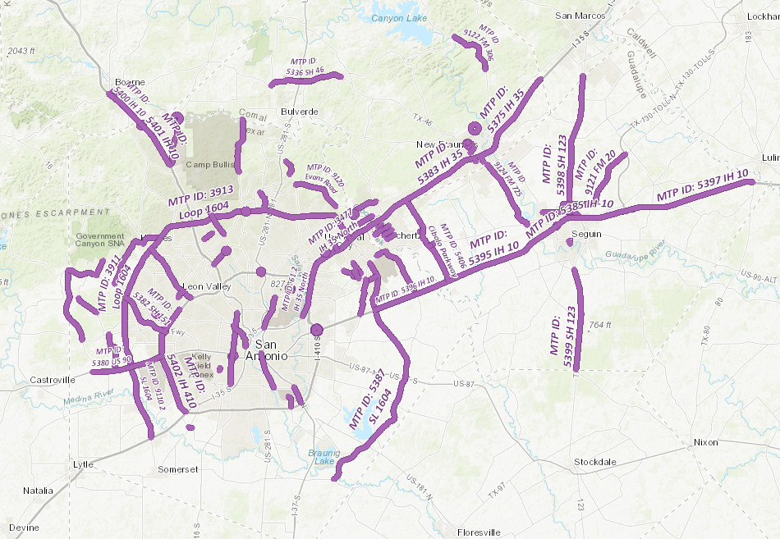
Metropolitan Transportation Plan

Slide 21
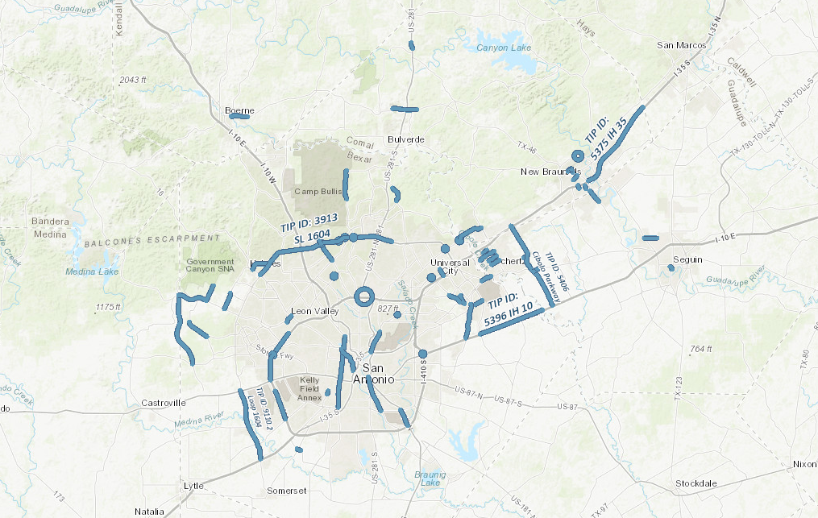
Transportation Improvement Program

Slide 22
Funding Future Mobility

Slide 23
100 gallons of fuel purchased in Texas yields…
$38.40
IN FUEL TAXES
$2.76
DONOR STATE
$18.40
$20.00
FEDERAL FUEL TAX
STATE FUEL TAX
$15.64
$20.00
$35.64
The state fuel tax was last raised in 1991. Inflation has since eroded purchasing power by more than 33 %.
$23.88
EROTED PURCHASING POWER

Slide 24
TIP State and Federal Funding Categories
CATEGORY 1
Preventive Maintenance and Rehabilitation
CATEGORY 2
Metropolitan Area Corridor
CATEGORY 3
Non-Traditional Funding Sources (local contribution)
CATEGORY 4
Connectivity
CATEGORY 7
Surface Transportation Program-Metropolitan Mobility (STP-MM)
CATEGORY 9
Transportation Alternatives
CATEGORY 11
District Discretionary
CATEGORY 12
Strategic Priority
TRANSIT
Project Funding

Slide 25
Major Funding Sources: State and Local Funding
Legislation | Source of Funding | Potential Funding
Proposition 1 November 4, 2014 | Rainy Day Fund | Variable Assumed $65 million/year Programmed 10 years of Proposition 1 funding in Mobility 2040 (2015 – 2024)
Proposition 7 November 3, 2015 | Sales and Use Tax + Motor Vehicle Sales and Rental Tax | Highly variable Difficult to estimate
84th Session of the Texas Legislature HB 1 (State Budget) | Ends diversions from the State Gas Tax | Approximately $620 million/year statewide Subject to change based on future legislative actions
Advanced Transportation District | Local Sales Tax | Funds go to local entities
Bexar County | Vehicle Registration Fees | Funds go to local entities

Slide 26
The planning landscape is constantly changing and evolving…

Slide 27
Ozone Standard Compliance Status San Antonio-New Braunfels MSA, 2015 - 2017 (as of May 21, 2018)
Regulatory Monitor Site | 4th Highest Reading, ppb |  |  | Current 3 Year Average
 | 2015 | 2016 | 2017
Camp Bullis C58 | 80 | 69 | 72 | 73
San Antonio NW C23 | 79 | 71 | 73 | 74
Calaveras Lake C59 | 68 | 62 | 65 | 65
Source: Alamo Area Council of Governments
The San Antonio area’s ozone values exceed the 2015 ozone threshold of 70 ppb.
This places the area in violation of the standard and, if the Environmental Protection Agency (EPA) designates areas in 2017 based on the 2015 – 2017 averaging period, this indicates the San Antonio area would be designated nonattainment for ozone.

Slide 28
Transportation Conformity
A non-attainment designation for ozone will require the MPO to undertake Transportation Conformity
Transportation Conformity means evaluating future transportation projects to ensure they do not cause further harm to air quality
Notes:
If we are designated nonattainment for ozone, this will require us to undertake transportation conformity, which means that we will have to evaluate future transportation projects to make sure they do not cause further harm to air quality

Slide 29
Top Counties for Numeric Growth in Texas 2015-2016 Presented by: Lloyd Potter, State Demographer, WTS Luncheon, February 21, 2018
2016-2017
County | U.S. Rank Population Change | Population Change | Percent of Change from Natural Increase | Percent Change from Domestic Migration | Percent Change from International Migration
Harris | 2 | 56,587 | 79.9% | -27.9% | 48.1%
Tarrant | 5 | 35,462 | 44.4% | 37.7% | 17.9%
Bexar | 7 | 33,198 | 44.6% | 39.3% | 16.1%
Dallas | 9 | 29,209 | 79.9% | -20.9% | 41.0%
Denton | 11 | 27,689 | 23.9% | 67.1% | 9.0%
Fort Bend | 13 | 27,388 | 24.8% | 59.4% | 15.8%
Collin | 14 | 26,506 | 25.8% | 58.7% | 15.5%
Travis | 17 | 24,505 | 44.2% | 33.3% | 22.5%
Williamson | 22 | 20,659 | 20.3% | 74.1% | 5.6%
Montgomery | 24 | 19,769 | 18.5% | 73.5% | 8.0%
Hidalgo* | 54 | 10,529 | 113.5% | -33.4% | 19.9%
Hidalgo County had negative net migration (-13.5% of total population growth).
Source: U.S. Census Bureau, 2016 Vintage Population Estimates
4
5
7
8
9
10
Notes:
This slide shows the most populous counties in Texas and their population rank nationwide. Bexar County is the seventh most populous county nationwide. The last three columns total 100%. Natural increase is birth minus deaths. Domestic migration is people moving from somewhere else in the U.S. In this one year time period, Harris County growth was due to births minus deaths. Harris County had negative domestic migration - people moved from Houston to other areas. Bexar County’s population increase was due to 45% births minus deaths . . .

Slide 30
Top Counties for Percent Growth* in Texas 2015-2016 Presented by: Lloyd Potter, State Demographer, WTS Luncheon, February 21, 2018
2016-2017
County | U.S. Rank | 2015-2016 Percent Population Change | Percent Change from Natural Increase | Percent Change from Domestic Migration | Percent Change from International Migration
Kendall | 2 | 5.2% | 0.1% | 95.9% | 4.0%
Hays | 3 | 5.1% | 16.0% | 82.2% | 1.8%
Comal | 6 | 4.4% | 9.5% | 88.5% | 2.0%
Williamson | 14 | 4.1% | 20.3% | 74.1% | 5.6%
Fort Bend | 18 | 3.8% | 24.8% | 59.4% | 15.8%
Montgomery | 24 | 3.7% | 18.5% | 73.5% | 8.0%
Rockwall | 25 | 3.6% | 15.3% | 82.2% | 2.5%
Denton | 28 | 3.6% | 23.9% | 67.1% | 9.0%
Kaufman | 36 | 3.4% | 16.5% | 81.3% | 2.2%
Bastrop | 42 | 3.1% | 15.8% | 83.5% | 0.7%
Ellis | 50 | 3.1% | 19.3% | 78.1% | 2.6%
5: 4.9%
4: 5.0%
2: 5.1%
*Among Counties with 10,000 or more population in 2016
Source: U.S. Census Bureau, 2016 Vintage Population Estimates
Notes:
While Bexar County is ranked 7th in numeric growth , Kendall and Comal are ranked 2nd and 6th nationwide in percentage growth. These three columns again, total 100%. But see how large these domestic migration percentages are. The growth is not due to babies being born but due to people moving to those counties from other areas. They bring with them cars, trucks, the need for housing, schools, retail, services, court systems and so forth! This is a one year percentage change. The transportation infrastructure in these high growth areas is being strained to its limits.

Slide 31
What does this mean for transit?
Influx of people looking for transportation options
Air quality concerns increase the need to reduce the percentage of single occupancy vehicles and vehicle miles traveled
Increasing need for new or improved fixed route transit in neighboring high growth counties

Slide 32
Stay Connected www.alamoareampo.org
Notes:
MPO Committee meetings are open to the public
Monthly Transportation Policy Board meetings are livestreamed via our website
Quarterly newsletter – “Spotlight on Mobility”
Bi-weekly e-newsletter – “Fast Track”

Slide 33
Questions? Linda Alvarado-Vela Planning/Public Involvement Program Manager (210) 230-6929 alvarado-vela@alamoareampo.org

