Slide 1
Rapid Transit Corridor Studies
June 16, 2018

Slide 2
Open House Information
Wednesday, June 20, 2018 5:30 – 7:30 p.m. Stinson Municipal Airport 8535 Mission Rd. San Antonio, TX 78214 VIA Route: 40
Thursday, June 21, 2018 5:30 – 7:30 p.m. The Neighborhood Place 3014 Rivas St. San Antonio, TX 78228 VIA Routes: 77, 524
Tuesday, June 26, 2018 5:30 – 7:30 p.m. Barbara Jordan Community Center 2803 E. Commerce St. San Antonio, TX 78203 VIA Route: 25
Wednesday, June 27, 2018 5:30 – 7:30 p.m. VIA Stone Oak Park & Ride 22139 US Highway 281 N. San Antonio, TX 78258 VIA Routes: 7, 503
Thursday, June 28, 2018 5:30 – 7:30 p.m. VIA Metro Center 1021 San Pedro San Antonio, TX 78212 VIA Routes: 3, 4, 20

Slide 3
What is it?
What is the goal?
The goal of these open house meetings is to share feedback from recent community conversations and discuss how that input was used to develop a Rapid Transit Corridor draft system proposal.
Rapid Transit is frequent, reliable public transportation with vehicles traveling in a dedicated lane. VIA’s Rapid Transit Corridor Studies will help determine which corridors are best suited for rapid transit service, based largely on community input.

Slide 4
Why Do We Need Transportation Options?
146
100,000+
new residents
in Bexar County since 2010
new residents arriving daily
=
1.6 million
1.3M+
new residents arriving between 2010 and 2040
additional cars on the road
Source: Alamo Area Metropolitan Planning Organization Model, Texas Department of Transportation Statewide Analysis Model, 2014; US Census Bureau; Texas A&M Transportation Institute Annual Urban Mobility Report 2015

Slide 5
Fast, Frequent and Reliable
More Mobility Options
Dedicated Lanes
Faster Travel
Modern
Economic Development
Convenient
Better for the Environment

Slide 6
Implementational Plans 2018 and beyond
2013 - 2014
City of San Antonio
Implementational Studies 2017
Arterial Plans | Regional Center Plans
2015 - 2016
VIA
Rapid Transit Corridor Studies
Rapid Transit System Plan
Planning Regional Efforts

Slide 7
Provide highly-reliable, direct connections between key activity centers
Address reliability issues with current bus service
Better serve current riders; attract new riders
Improve overall mobility
Strengthen competitiveness of transit
Support region’s land-use vision and growth
Leverage local investments in infrastructure
Allow people to live closer to jobs; save time/money
Provide high-quality transportation choices
Strengthen regional multimodal connections
Promote the region’s land-use vision
PURPOSE
NEED
Proposed System Purpose & Need

Slide 8
Rapid Transit Corridor Studies | Process
Community Engagement | Spring - Fall 2017
WE ARE HERE
CONCEPTUAL ALTERNATIVES
DETAILED ALTERNATIVES
Establish purpose and need for rapid transit in seven corridors
Screen alternative routes and
modes through each corridor
COMMUNITY ENGAGEMENT
Fall 2017
Fall 2017

Slide 9
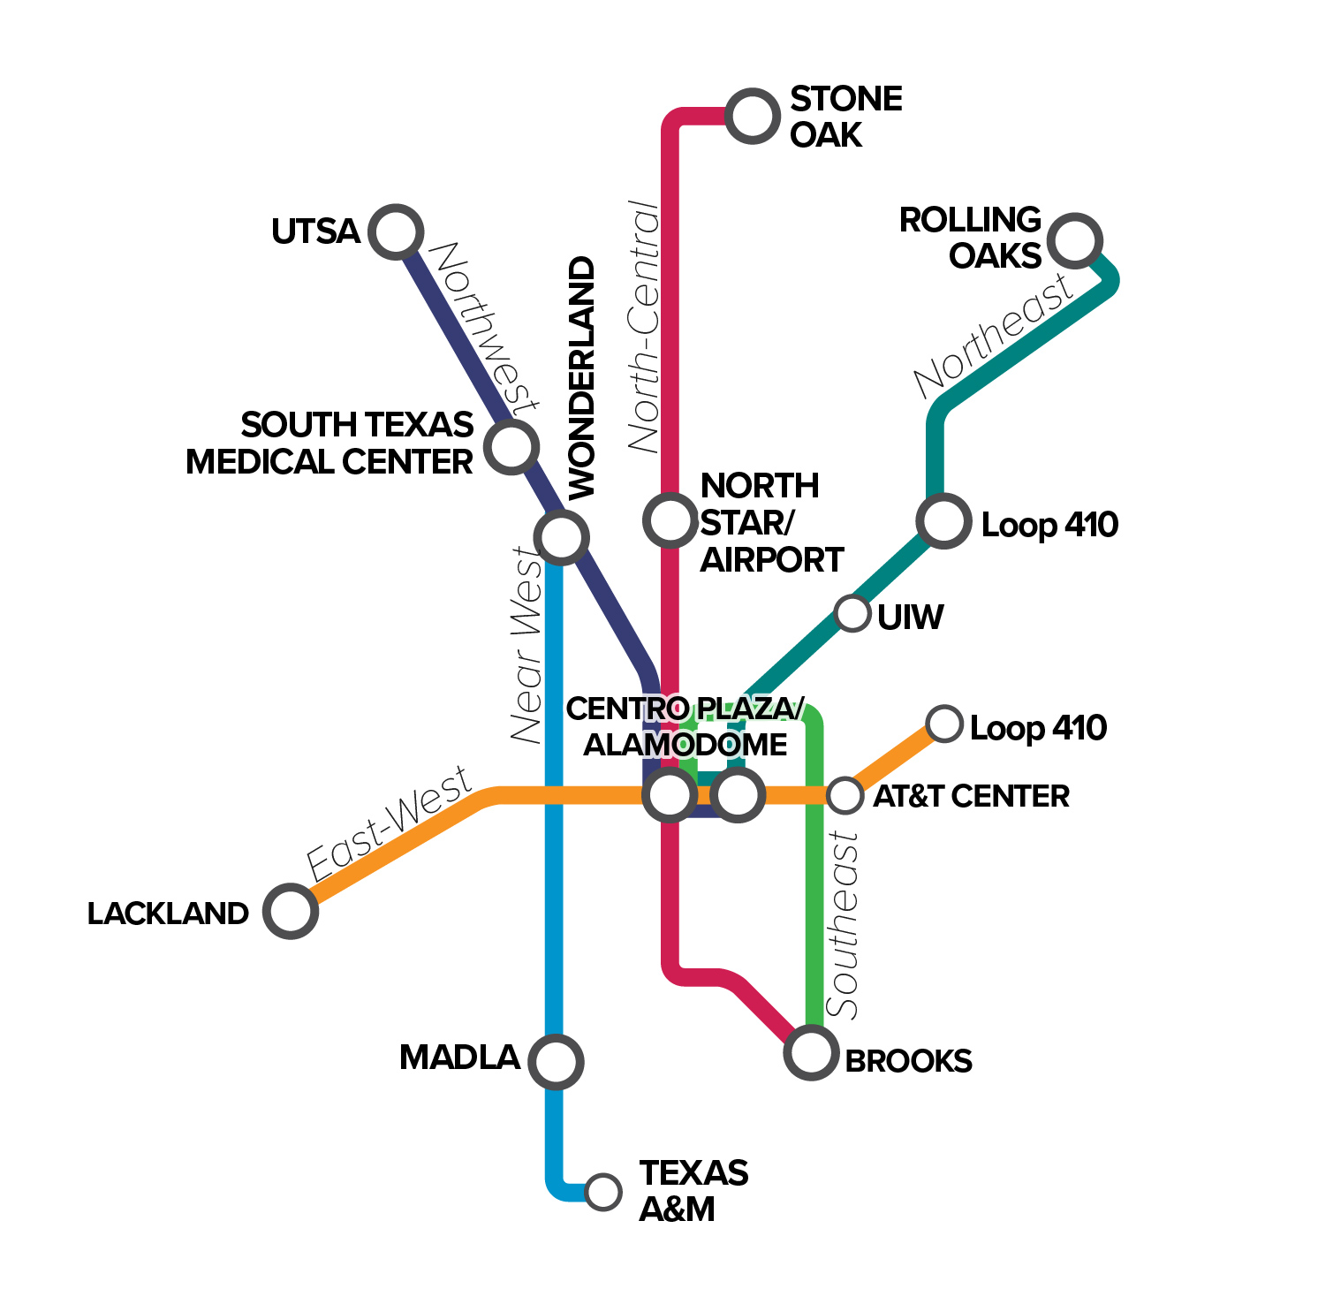
Rapid Transit Corridor Studies | Process
Winter 2017-Spring 2018
Summer 2018
WE ARE HERE
PREFERRED ALTERNATIVES
DRAFT RAPID TRANSIT NETWORK
Establish recommended alignments, station locations, and operating plans
Community engagement
COMMUNITY ENGAGEMENT
Fall 2017
Fall 2017

Slide 10
VISION 2040 GOALS & OBJECTIVES
What was considered during evaluation of the rapid transit alternatives?
Evaluation Criteria

Slide 11
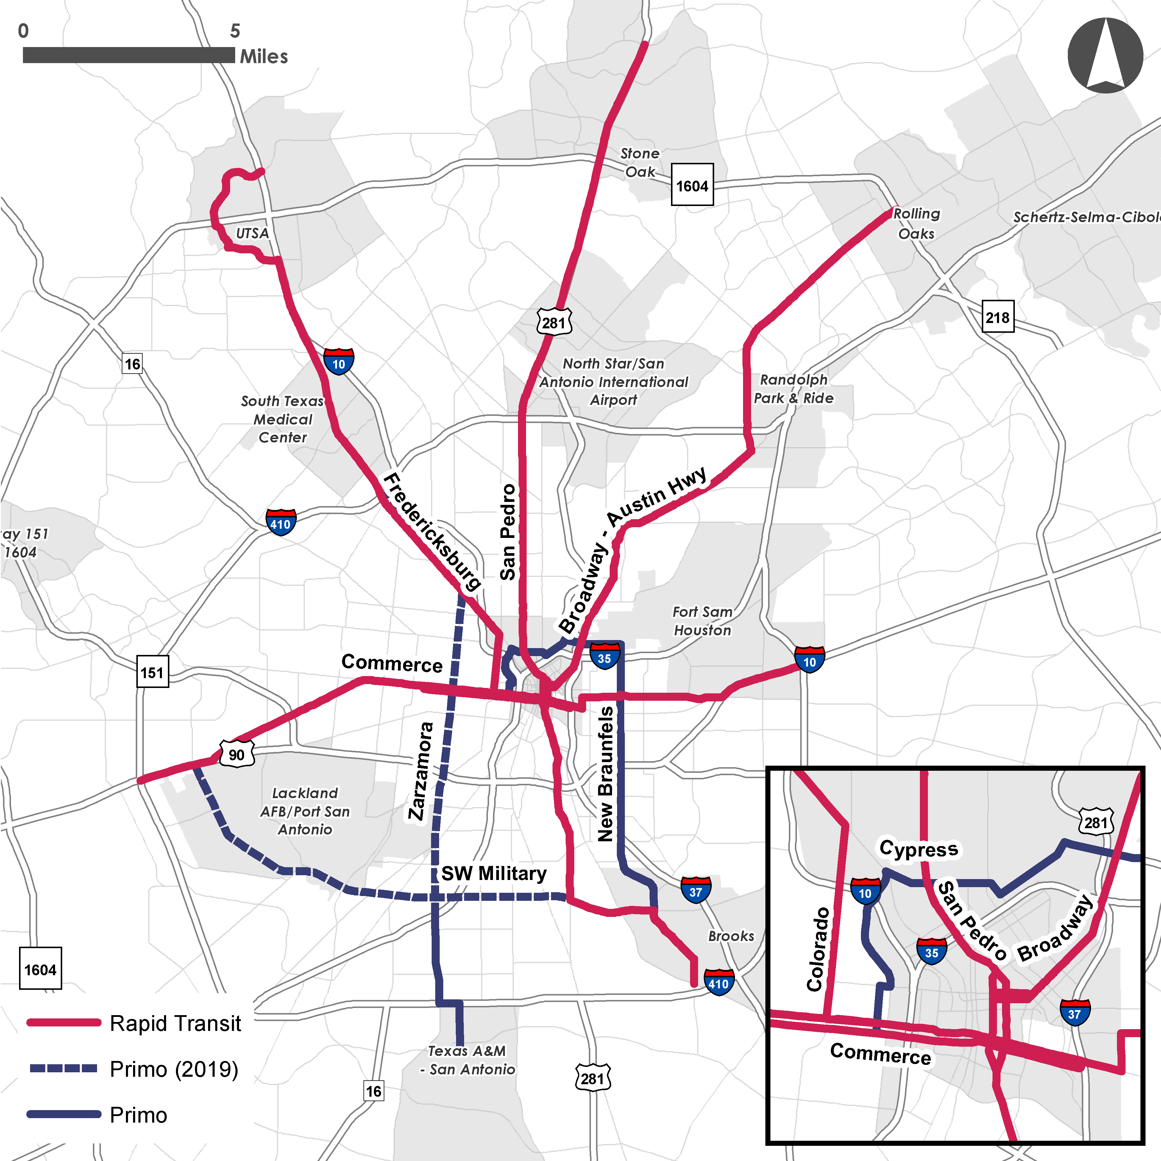
Rapid Transit Network
Draft Proposal
Guided by years-long studies of the region’s most-traveled corridors and with public input from the community meetings.
DRAFT
Draft Rapid Transit Network

Slide 12
A Rapid Transit Network Plan will be completed in Fall 2018.
This plan will:
List proposed rapid transit projects needed in the region through 2040
Identify a preliminary implementation schedule
Integrate rapid transit with existing VIA services
DRAFT
Implementing the Rapid Transit Network

Slide 13
Call to Action
Share your comments.
Email your comments to VIA at GCR@viainfo.net | Subject: RTC
Mail your comments to: VIA Metropolitan Transit, c/o Government & Community Relations 800 W. Myrtle, San Antonio TX 78212
Visit VIAinfo.net/rapidtransit
Deadline for comments is July 16, 2018

